Slide 1
Production‑Grade RAG Architecture – Executive Overview
Ramachandra – Software Architect

Slide 2
Problem Statement
Why Generative AI Alone Is Not Enterprise‑Ready
Large Language Models are powerful—but on their own, they are not suitable for critical business use.
They are trained on public, generic data, not your company’s knowledge
They cannot reliably access proprietary, confidential, or domain‑specific information
They may produce confident but incorrect answers, creating operational and reputational risk
They offer limited traceability and explainability, which raises compliance and trust concerns
Bottom line:
Without additional controls, GenAI cannot be safely deployed for core enterprise workflows.

Slide 3
Solution
Retrieval‑Augmented Generation (RAG)
RAG converts GenAI from an experimental tool into a business‑ready capability.
It works by:
Retrieving relevant internal knowledge in real time
Combining that knowledge with the AI model before it responds
Ensuring answers are grounded in verifiable, approved sources
Result:
More accurate and consistent responses
Clear traceability to source data
AI that leadership, regulators, and customers can trust

Slide 4
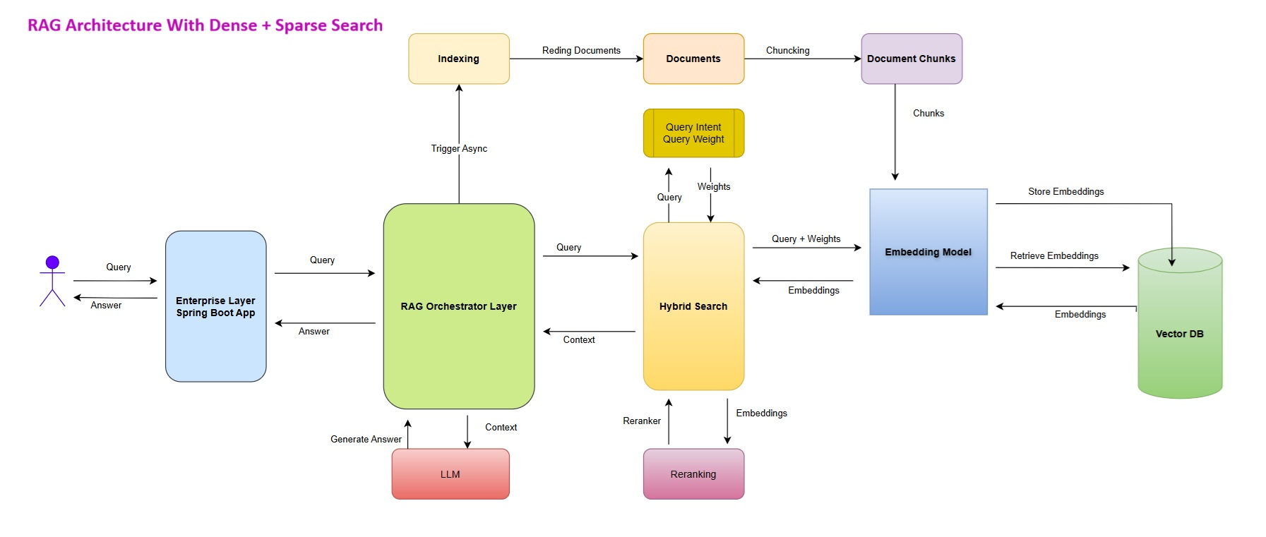
RAG High-Level Architecture

Slide 5
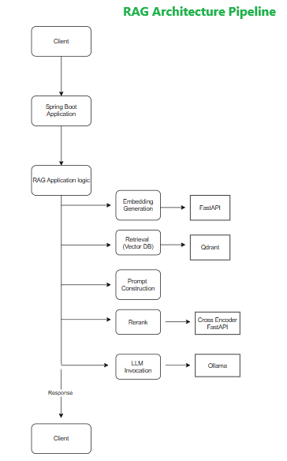
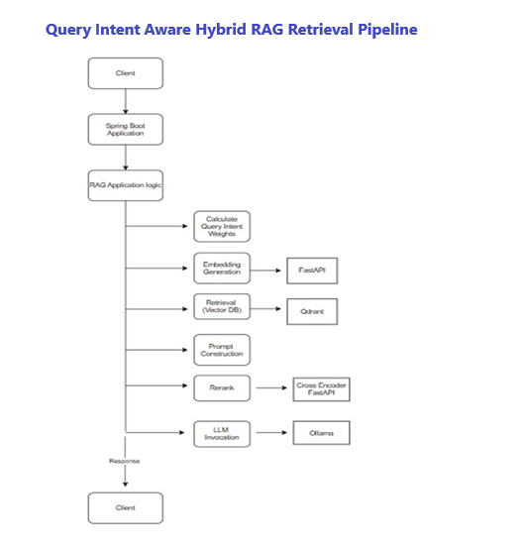
RAG High-Level Architecture - Pipeline

Slide 6
Why This Architecture Is Enterprise‑Ready
Data Ingestion Layer
Supports ingestion of structured and unstructured enterprise content
Embedding & Vector Storage
Use a configurable embedding model, stores in a vector database, enables high‑accuracy and relevance ranking
Retrieval Layer
Semantic retrieval, top‑K relevant results, applies metadata filtering
Prompt Engineering & Context Injection
Reduces hallucinations through “answer‑from‑context‑only” enforcement
LLM Integration
Designed to be model‑agnostic, enabling future model swaps
Response Post‑Processing
Cleans and formats generated responses
Provides traceability and source attribution where applicable
This implementation delivers a production‑ready RAG platform that ensures accurate, traceable, and scalable Generative AI responses using enterprise data.

Slide 7
Thank you

